Slide 1
COMP6940: BIG DATA AND DATA VISUALISATION
LECTURE #3: DATA INTEGRATION, DATA ETHICS, AND FAIRNESS
Inzamam Rahaman

Slide 2
AGENDA
Data Integration
Data Ethics
Overview of data ethics
Short examples
Five C’s of data ethics
Quick overview of GDPR implications for data science
Fairness in Data Science (Nvidia Slides)

Slide 3
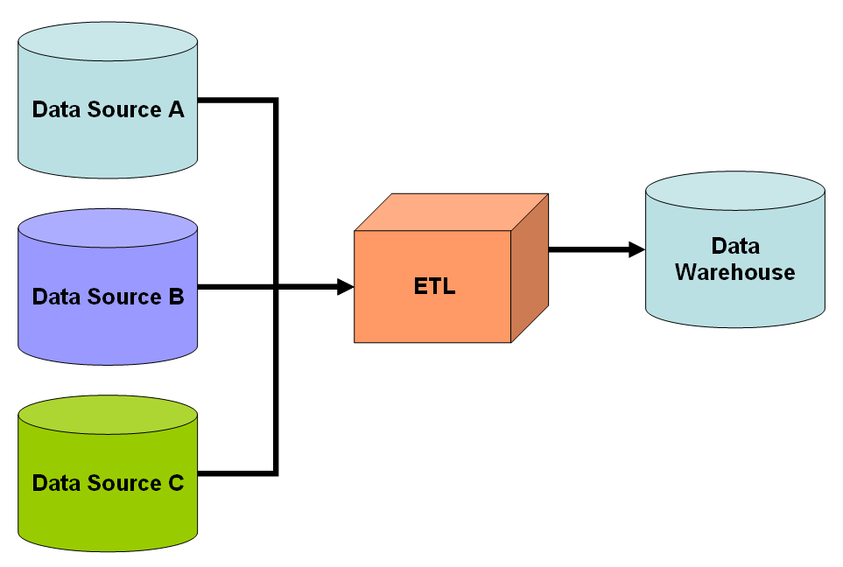
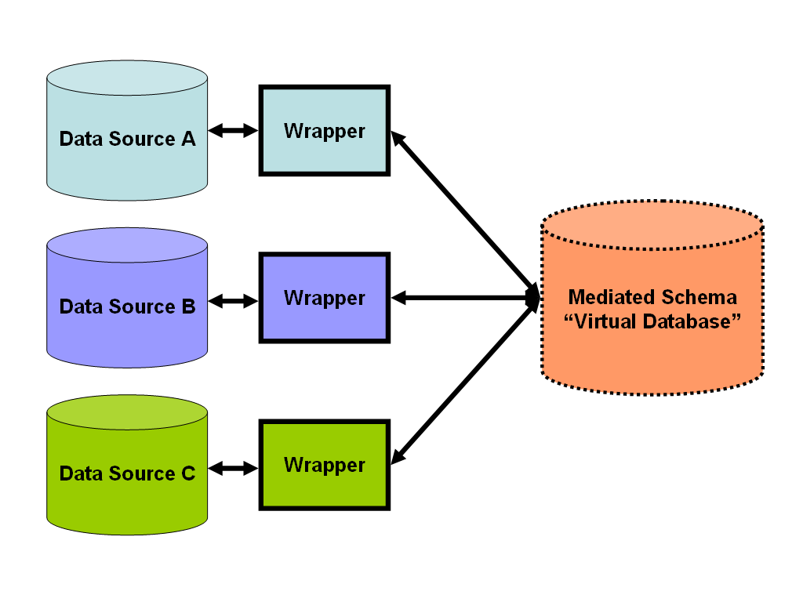
DATA INTEGRATION
Data can exist across several source systems.
Think bank: account database, application logs, website logs, etc…
Often data across source systems must be intergrated and collated do interesting analytical work
This is often done through ETL pipelines
Extract: extract data from source systems
Transform: clean, pre-process, and prepare
Load: load into data warehouse or “virtual database” that acts like a data warehouse in interface

Slide 4

DATA ETHICS
Data science + Big data = big impact
Big impact = large risks and potential for harm
We need to consider ethical issues as we practice data science

Slide 5
DATA ETHICS
Complicated topic
No hard and fast rules
Decisions are context-dependent
We look at some general themes to help inform your decision making:
Misrepresentation
Privacy and Consent
Algorithmic injustice
Core takeaway: please be active in thinking about ethics in your data science practice

Slide 6
MISREPRESENTATION
”There are three kind of lies: lies, damned lies, and statistics”
Attributed to British PM Disraeli by Mark Twain
Responsible statistics is a powerful tool for navigating the world
Irresponsible statistics can mislead and misinform
Sometimes with an agenda
Sometimes accidental
Honesty is the chief of the epistemic virtues: all try to represent and communicate reality as best as possible.
Falsification: try to falsify your own ideas as best practice
Learn about cognitive bias and try to develop strategies and structures to avoid/minimize them

Slide 7
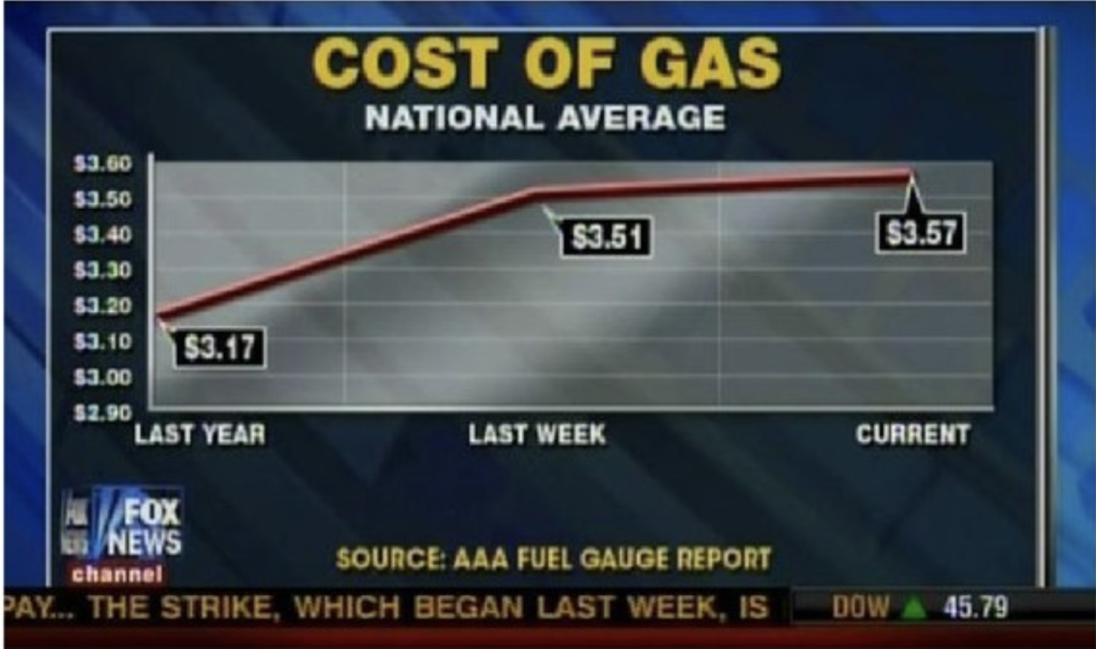

Slide 8
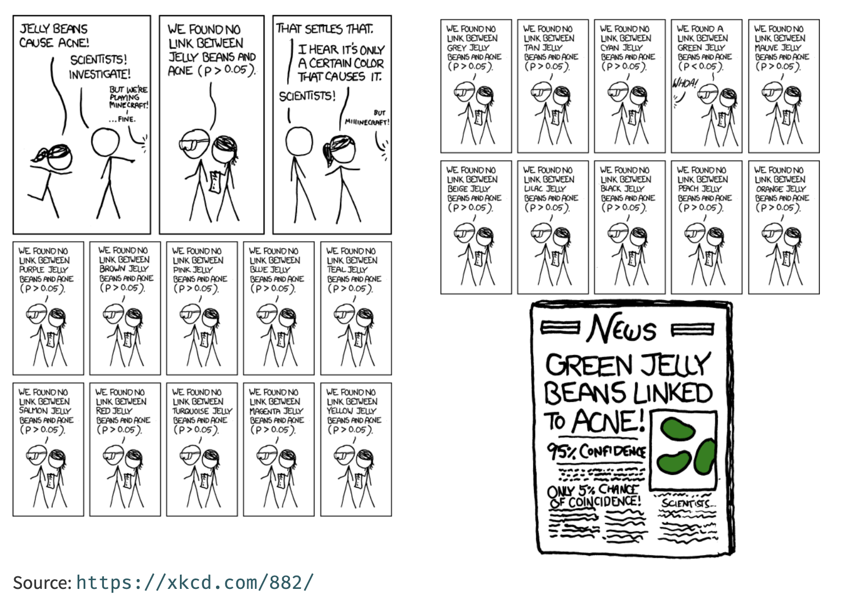

Slide 9
PRIVACY
Users and customers trust companies with a lot of personal data for basic use of services
As data professionals, we need to ensure that
Access to data is managed to prevent the leakage of personal information
We do not gather and use customer’s personal information under false pretences

Slide 10
PRIVACY – OK CUPID
OK Cupid is a data website
In 2016, 70K profiles were published, providing intimate details about users
Some may object to the ethics of gathering and releasing this data. However, all the data found in the dataset are or were already publicly available, so releasing this dataset merely presents it in a more useful form.
Researchers Emil Kirkegaard and Julius Daugbjerg Bjerrekær
Data were anonymized, but details could still be recovered from usernames ☹
Need to think about how to minimize violation of reasonable expectation of privacy

Slide 11
PRIVACY – CAMBRIDGE ANALYTICA
Seeders paid to take personality quiz
Personality quiz app scraped profile to build model of user’s likes, dislikes, opinions, etc…
Data integrated with other publicly accessible data to create models for manipulating users

Slide 12
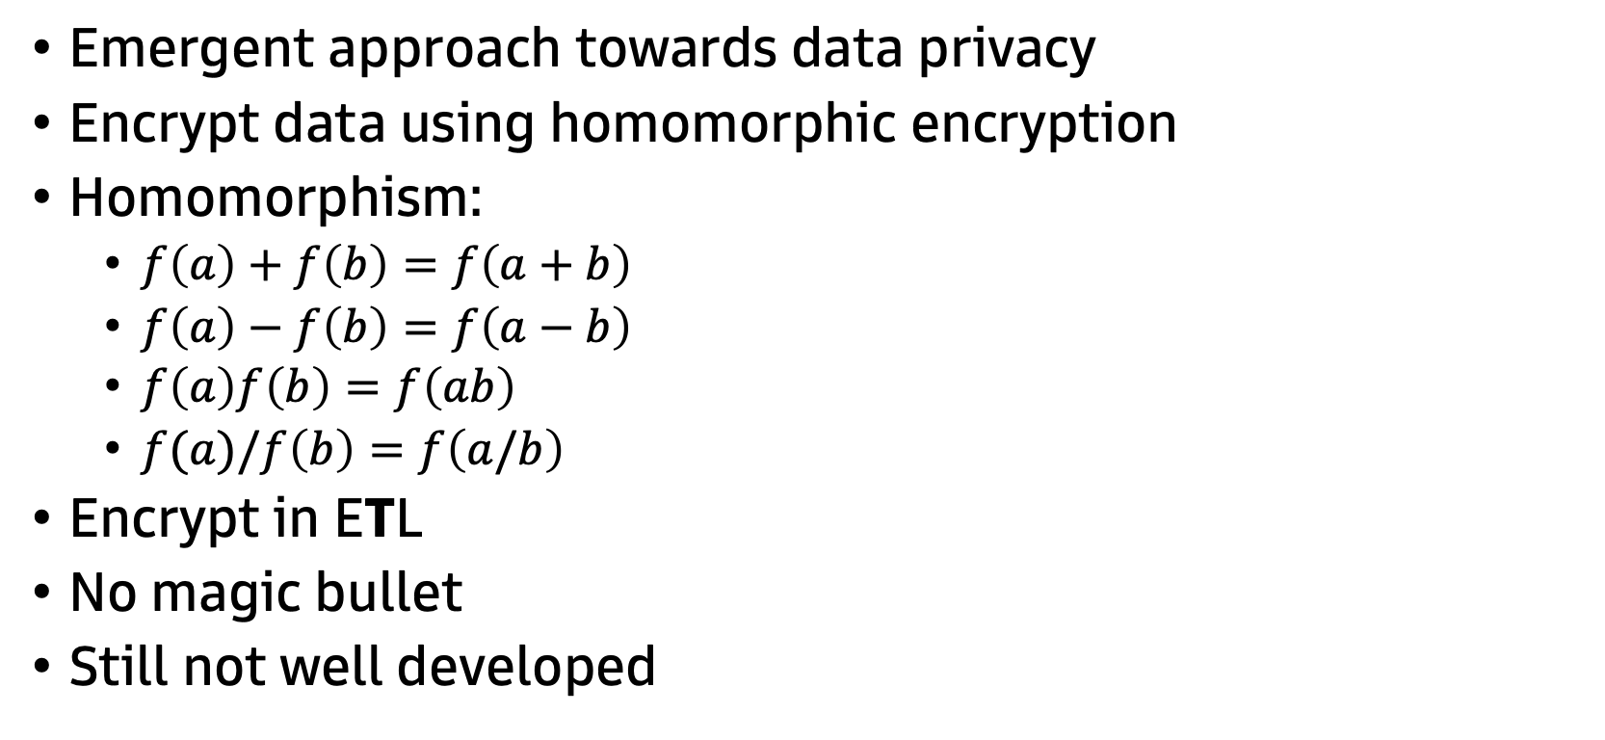
PRIVACY – HOMOMORPHIC ENCRYPTION
Emergent approach towards data privacy
Encrypt data using homomorphic encryption
Homomorphism:
$f\left(a\right)+f\left(b\right)=f\left(a+b\right)$
$f\left(a\right)−f\left(b\right)=f\left(a−b\right)$
$f\left(a\right)f\left(b\right)=f\left(ab\right)$
$f(a)/f\left(b\right)=f\left(a/b\right)$
Encrypt in ETL
No magic bullet
Still not well developed

Slide 13
ALGORITHMIC INJUSTICE
Algorithms have the potential to improve our exercise of ethics
But can also entrench and embody negative behaviour and attitudes
Sometimes with horrid consequences
For example, some misuse of machine learning could make racism/sexism worse

Slide 14
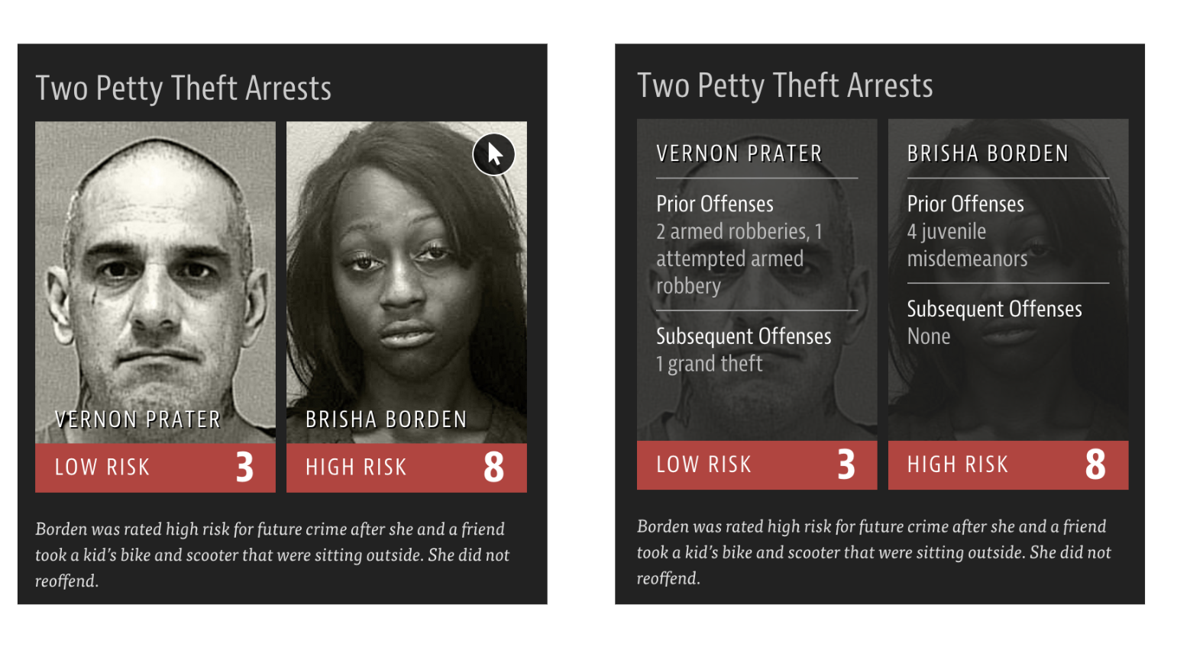

Slide 15
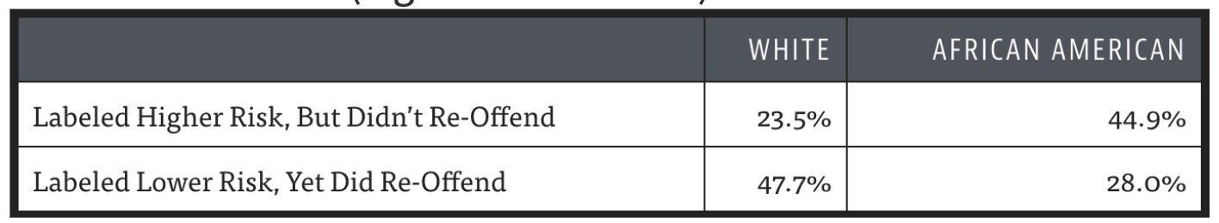
ALGORITHMIC INJUSTICE - COMPASS
Tried to predict recidivism over 2 year horizon
20% of those predicted to commit violent crimes actually did
The algorithm was unfair to African-Americans

Slide 16
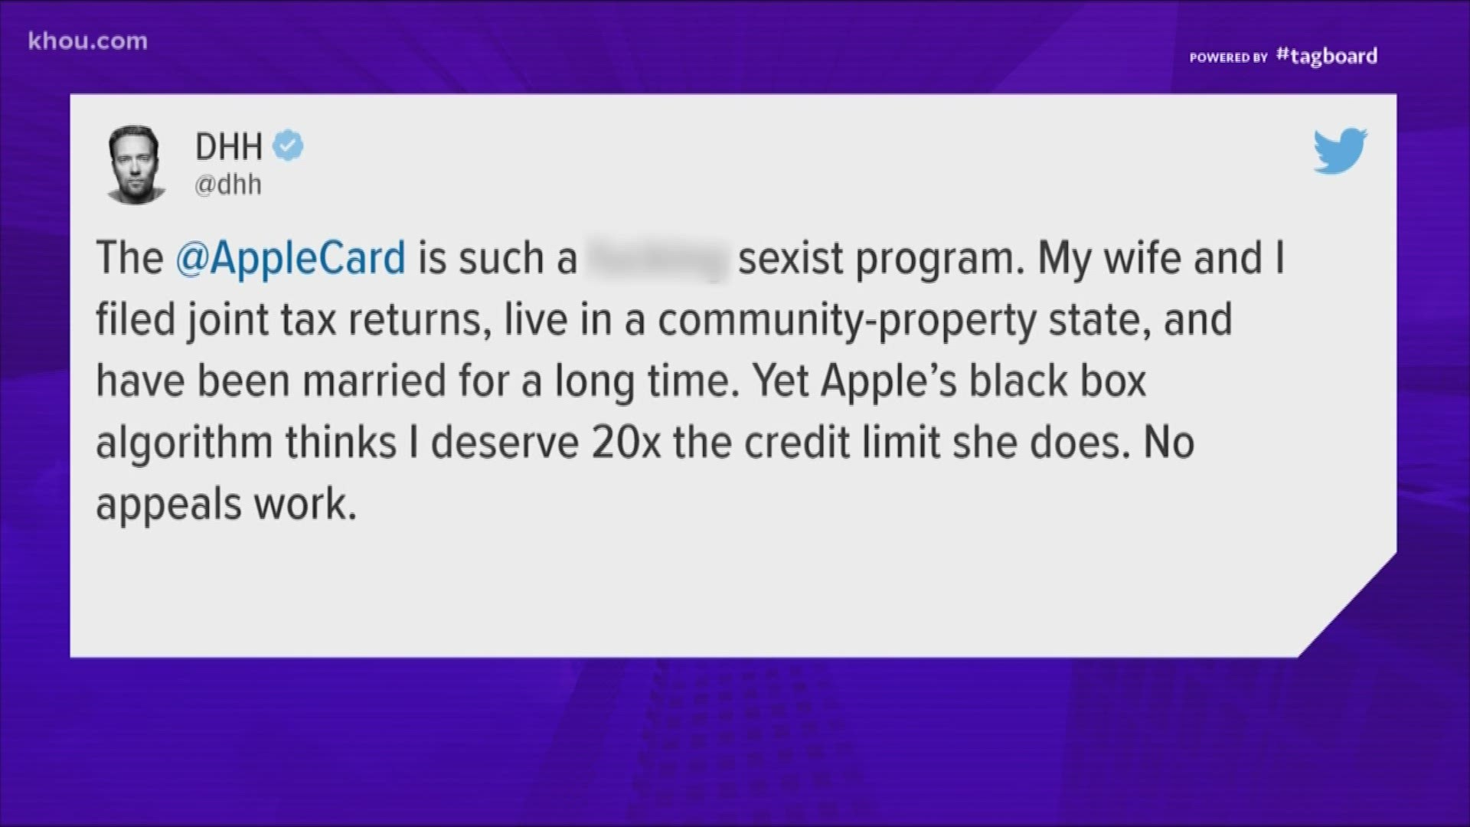
ALGORITHMIC INJUSTICE – CREDIT SCORING
Apple developed algorithm to help set limits on Apple Cards
Algorithm underestimated suitable credit allowances to female applicants

Slide 17
ETHICS
Five C’s:
Consent
Clarity
Consistency
Control
Consequence
Good framework for thinking about ethics in data science

Slide 18
GDPR – General Data Protection Regulation
EU-based legislation for protection of consumer data
Caused a lot of annoying cookie messages when released
Applicable in EU, but legislation across globe taking notes
Core implications for DS:
Data processing: data can only be used to expressed purpose for which it is collected and “reasonable” purposes, e.g. money laundering and fraud detection
Right to explanation: a user has the right to know how an automated system has arrived at a decision about them
Bias and discrimination: a user has the right not to be discriminated against by virtue of protected characteristics through an automated system

Slide 19
NVIDIA SLIDES

Slide 20
QUESTIONS?

